Slide 1
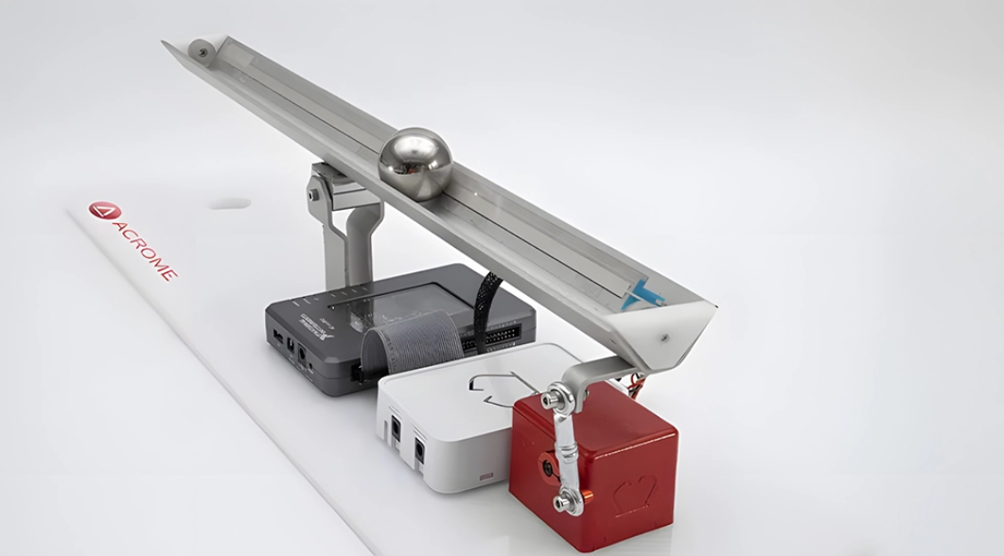
One Axis ball balancing Robot

Slide 2
Introduction
A One-Axis Ball Balancing Robot is a feedback-controlled system that maintains the position of a ball on a beam by adjusting the beam's tilt using a servo motor.
Our objective is to design and implement a real-time closed-loop control system that senses the ball's position and stabilizes it using a PID controller.
This project demonstrates the core concepts of control systems and provides practical exposure to feedback and system stability

Slide 3
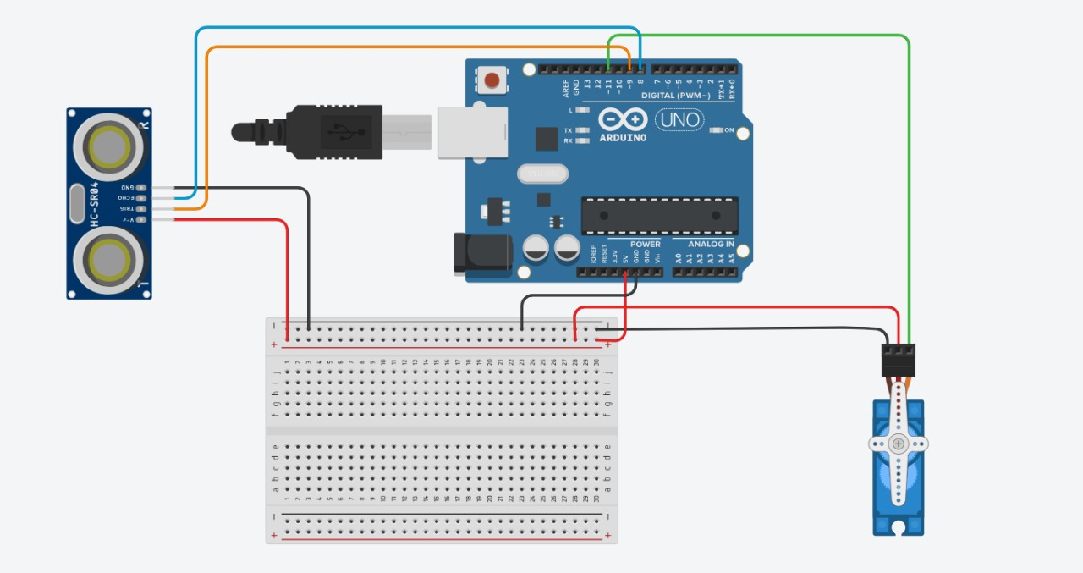
Circuit Diagram

Slide 4
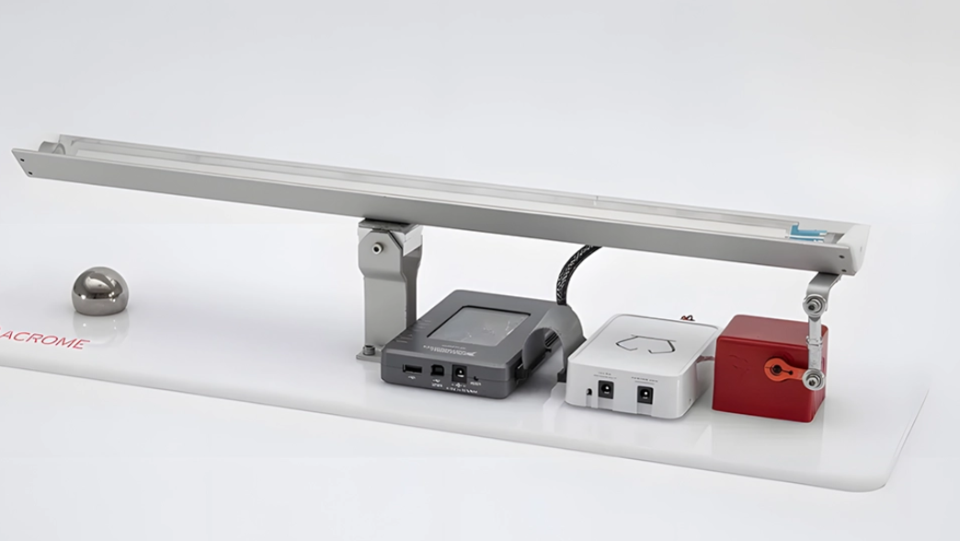
Working
Sensing the Ball Position
Moving Average Filter
Error Calculation between the measured and the desired setpoint
PID Control Logic
Proportional (P): Reacts to current error.
Integral (I): Accounts for past error accumulation.
Derivative (D): Predicts future error trend.
The servo motor tilts the beam in real time to counteract the ball’s movement and restore it to the setpoint.
Stability Monitoring

Slide 5
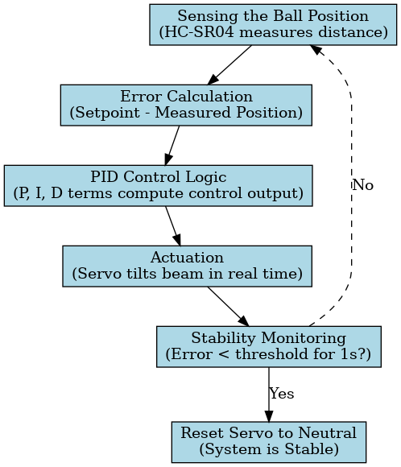
Flowchart

Slide 6


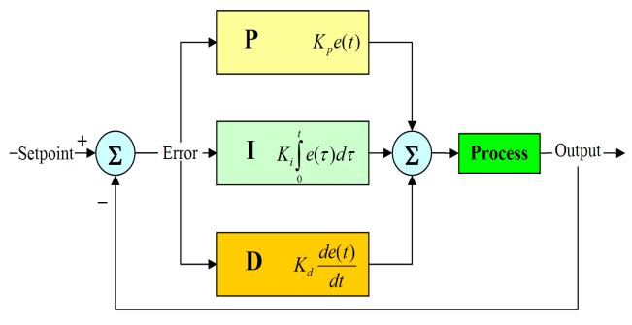
PID control: The Brain Behind balance
e(t)=error =|measured distance - setpoint|
Output= angle sent to servo motor
Tuning Constants:
Kp: Fast response
Ki: Reduce steady state error
Kd: Predicts future error

Slide 7
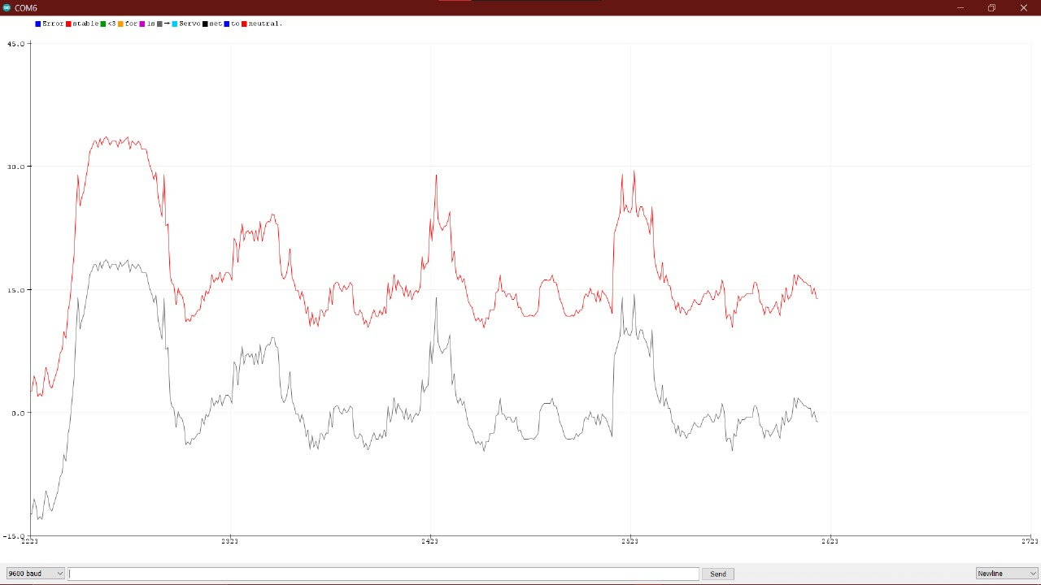
Results
X axis: time
Y axis: distance from edge
achieved system stability within 30 seconds of the disturbance introduced
Final Values of gains after tuning:
Kp=5
Kd=9 Ki=0.01

Slide 8
Theory vs. Practice: Lessons from PID Tuning
Theoretical Expectation
PID promises stable, smooth and accurate control
Tuning gains should yield predictable system responses (Tr,Ts,%OS,steady state error)
Ideal conditions are assumed i.e linearity, no noise, no air of fan, no delay, no friction, and the list goes on
Practical Reality
PID tuning was not intuitive- small changes caused instability
Sensor noise (ultrasonic jitter) and actuator lag introduced unpredictability
System behaved non linearly due to friction, backlash and motor throwing the beam off the hinge

Slide 9
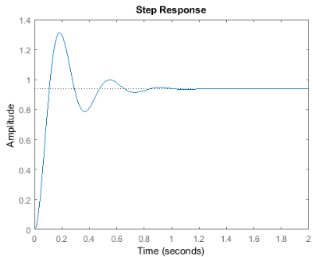
Analysis & Discussion
Theoretical concepts provided a clear picture of what to expect — but not how to achieve it in practice.
Empirical tuning (trial-and-error) became essential to reach stability and desired performance.
Real-world tuning demanded:
Intuition and patience
A deep understanding of system limitations, such as sensor noise, mechanical imperfections, and response delays.

Slide 10
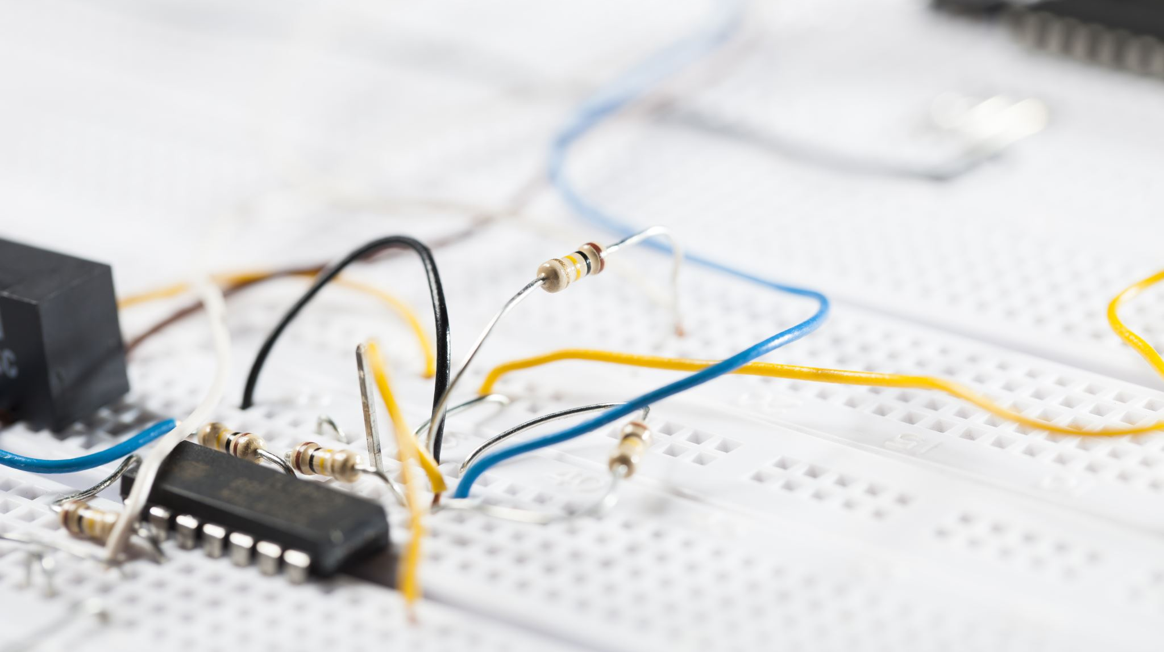
Current Research Areas
Advanced Control Strategies: A fuzzy PID-incorporated stochastic gradient descent algorithm for fast and accurate latent factor analysis
Machine Learning for Control: Conformal pid control for time series prediction
Multi-axis Extension: Expanding from 1D to 2D/3D balancing platforms for drone landing pads, humanoid robots, and mobile platforms.
Miniaturization & Embedded Systems: PID controller design with a new method based on proportional gain for cruise control system

Slide 11
Conclusion
PID Controller remains a cornerstone in modern control systems due to its simplicity, robustness and effectiveness
Through this project, we implemented and analyzed the behavior of a PID-controlled system, tuning parameters to achieve optimal system performance
Advanced tuning techniques and adaptive PID variations offer exciting research directions to handle nonlinearity, time delay, and system uncertainties
As industries continue to demand smarter and more efficient control systems, PID control—especially in adaptive and intelligent forms—remains highly relevant in robotics, automation, and electrical systems

Slide 12

References
Ogata, K. (2010). Modern Control Engineering (5th ed.). Prentice Hall.
Dorf, R. C., & Bishop, R. H. (2016). Modern Control Systems (13th ed.). Pearson.
Arduino.cc. Arduino Reference & Servo Library Documentation.
Levine, W. S. (Ed.). (2011). The Control Handbook (3rd ed.). CRC Press.
https://acrome.net/product/ball-and-beam

